Slide 1
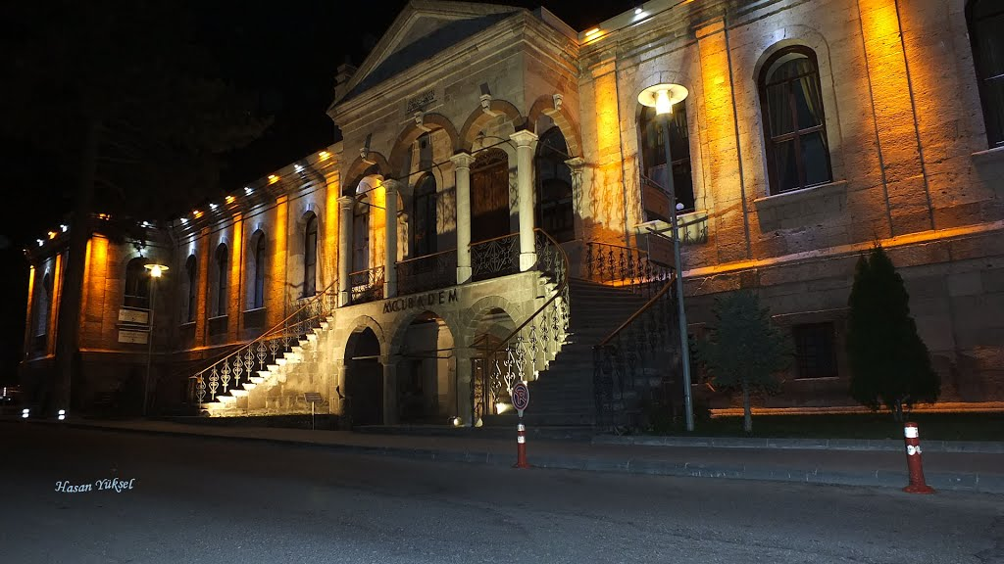
Delivery of Stem Cells to the Retina: Findings from our studies
Dr. Neslihan Sinim Kahraman FEBO
Prof. Dr. Ayşe Öner FEBO
Dr. Duygu Gülmez Sevim, FEBO
Acıbadem Health Group, Kayseri Hospital
TURKEY

Slide 2
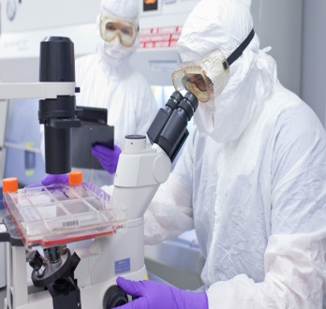
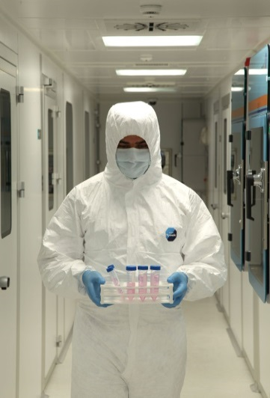
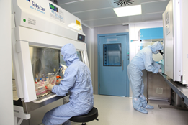
Stem cell based treatment modalities are rising in trend for irreversible neuropathies and retinopathies.
These treatment options are giving hope for reversing the cell death or damage; or at least causing the functional enhancement of the remaining viable cells through nutritional support and anti-apoptotic effect.
Various ways of application routes and sources of the cells have been proposed up-to date

Slide 3
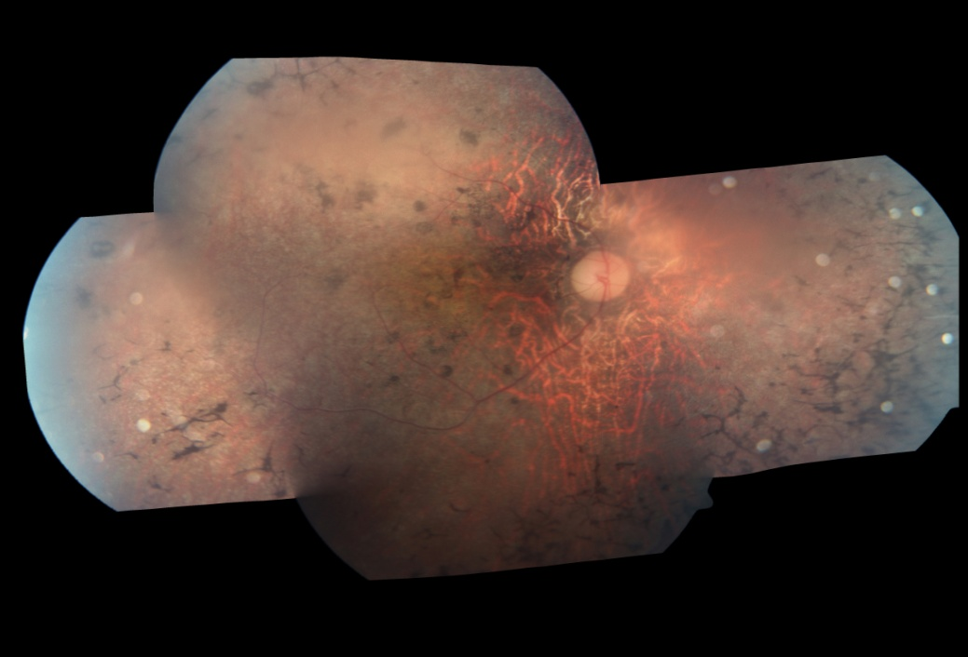
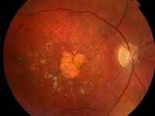
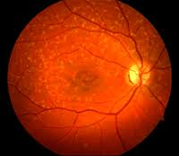
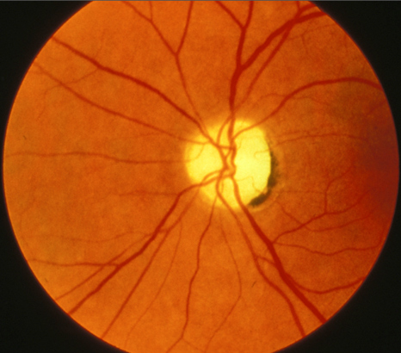
RP, AMD, STARGARDTS’ MACULAR DYSTROPHY, OPTIC NEUROPATHY

Slide 4
Clinicaltrials.gov
Embryonic stem cells
Retinal progenitor cells
Adult stem cells: Adipose tissue mesenchymal stem cells, Bone Marrow derived CD34+hematopoetic cells, Dental Pulp derived cells, Umbilical cord derived mesenchymal cells, Induced pluripotent stem cells

Slide 5
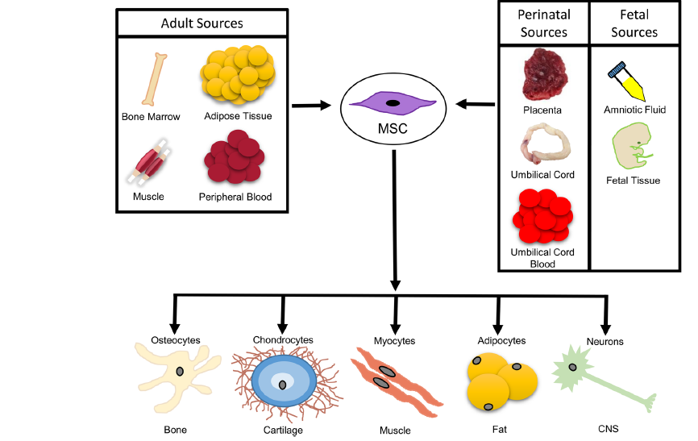

Slide 6

The eye is a good target for cellular replacement therapies.
The transplantation site and cells can be monitored via clinical examination and high resolution imaging devices.
There are clinical measures ways like visual acuity, contrast sensitivity, microperimetry and electrophysiology.
Small volumes and numbers of replacement cells can be enough compared to other bodily organs.
Surgical accessibility to the eye and the retina permits the delivery of cells in suspension, or as sheets on a scaffolding material that could promote the survival of transplanted cells

Slide 7
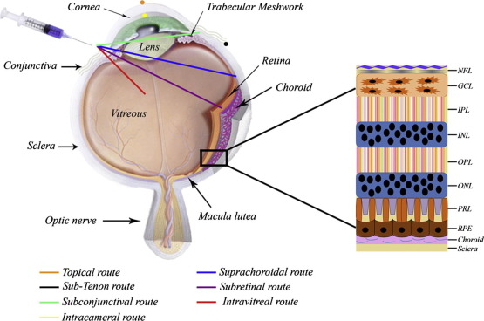
Intravitreal
Subretinal
Subtenon
Retrobulber
Peribulber
Suprachoroidal

Slide 8
Subretinal Adipose Derived MSC
First study of our group which included 11 patients with end-stage RP who received subretinal implantation of ADMSCs.
All patients had a total visual field defect and five of them only had light perception.
The worst eye of the patient was operated on and, after total vitrectomy with a 23 gauge, ADMSCs were injected subretinally.
All 11 patients completed the 6-month follow-up. None of them had systemic complications.

Slide 9
Five patients had no ocular complications.
One of the patients experienced CNVM at the implantation site and received an intravitreal anti-vascular endothelial growth factor drug once.
Five patients had epiretinal membrane around the transplantation area and at the periphery, and received a second vitrectomy and silicon oil injection.
Only one patient experienced an improvement in visual acuity (from 20/2000 to 20/200), visual field, and ERG.
Three patients mentioned that the light and some colors were brighter than before and there was a slight improvement in BCVA.
The remaining seven patients had no BCVA improvement (five of them only had light perception before surgery).

Slide 10
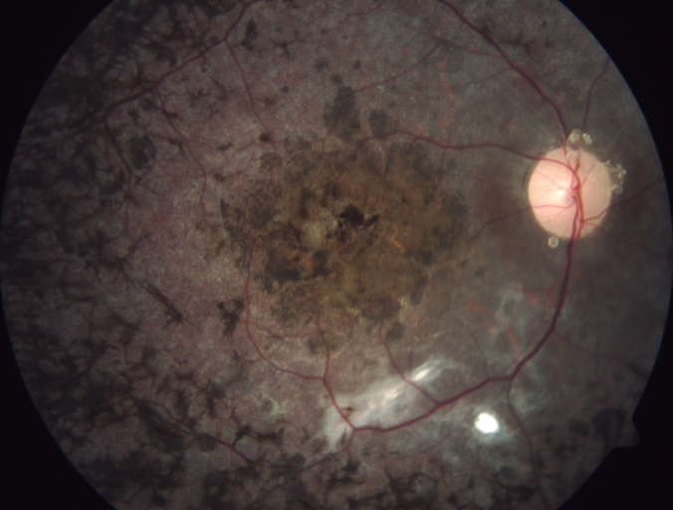
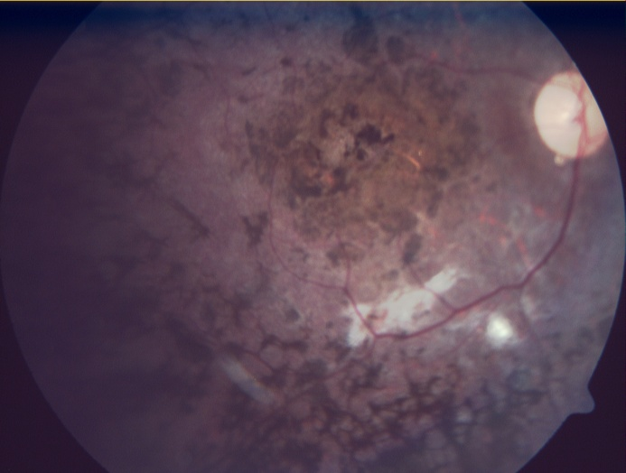
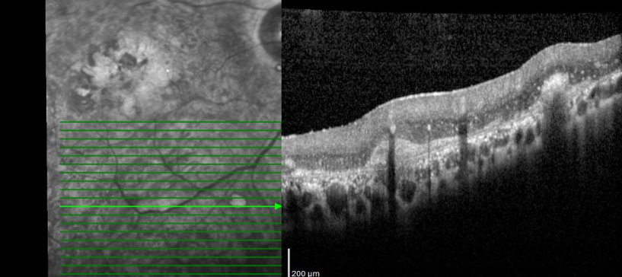
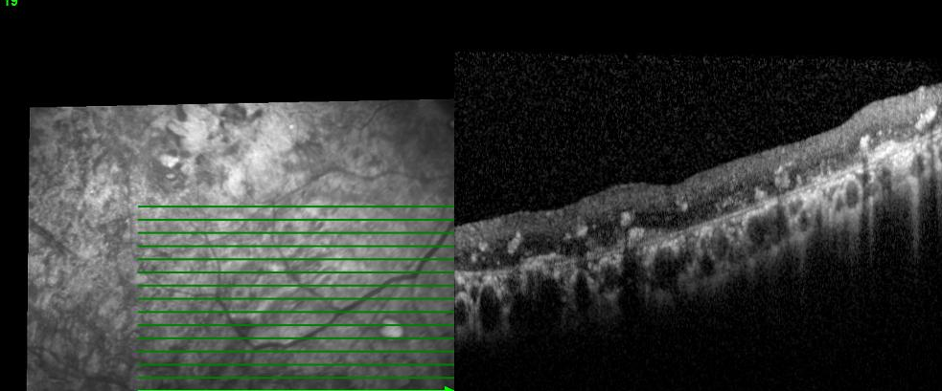
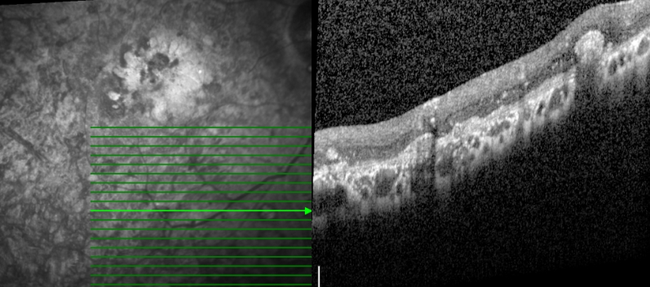
Fundus photos of postoperative 6 months and 4 years
OCT of the injection side of a patient at first month, 1. year and 4. years

Slide 11
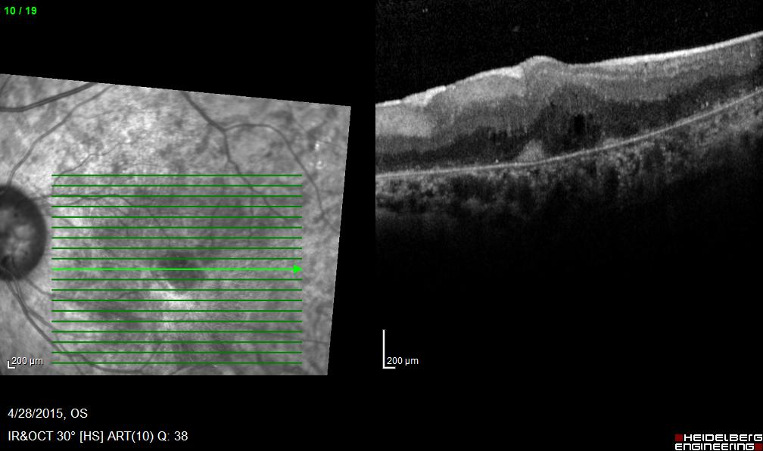
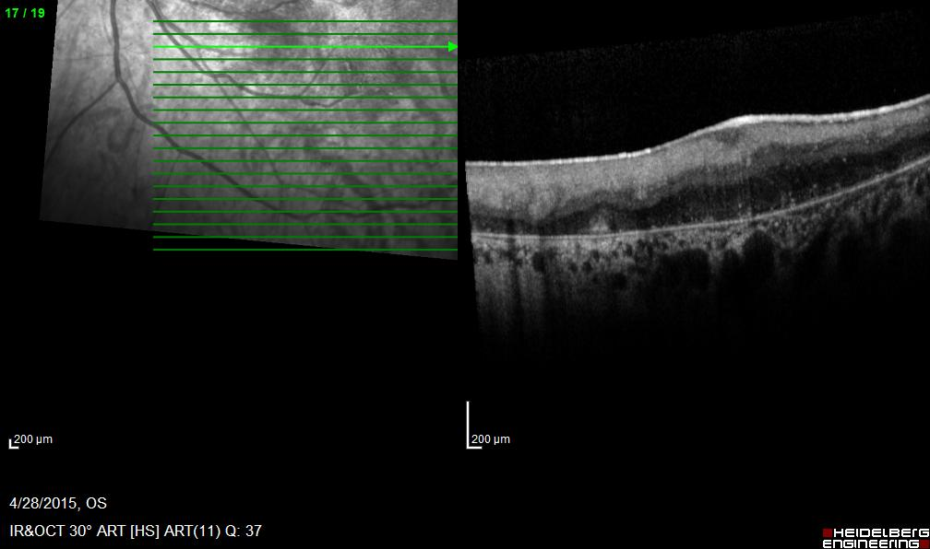
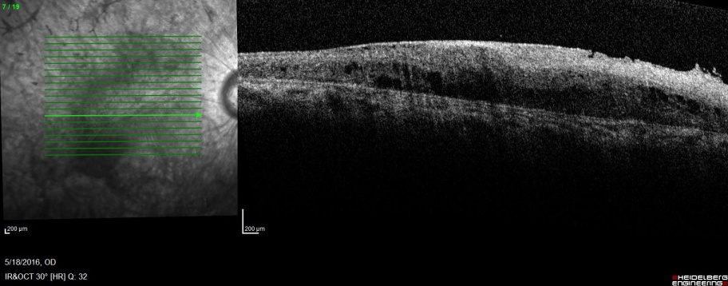
OCT scans of ERM formation

Slide 12
Adipose-derived MSC preparations used for subretinal and intravitreal injection may contain cells differentiating into autologous fibroblasts.
The presence of autologous fibroblasts can be explained as the cause of proliferative vitreoretinopathy and retinal detachment after injection.
Therefore, the transformation and proliferation abilities are very important after subretinal/ intravitreal stem cell therapy.

Slide 13
Suprachoroidal Adipose derived MSC
In another study we aimed to investigate the safety and efficacy of suprachoroidal adipose tissue-derived mesenchymal stem cell (ADMSC) implantation in patients with dry-type age-related macular degeneration (AMD) and Stargardt’s macular dystrophy (SMD).
This study included four patients with advanced-stage dry-type AMD and four patients with SMD .
None of them had any systemic or ocular complications. All of the eight patients experienced visual acuity improvement, visual field improvement, and improvement in mf-ERG recordings.
Stem cell treatment with suprachoroidal implantation of ADMSCs seems to be safe and effective in the treatment of dry-type AMD and SMD.

Slide 14
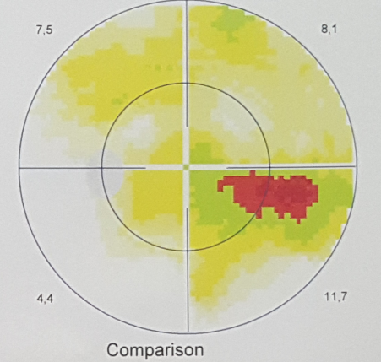
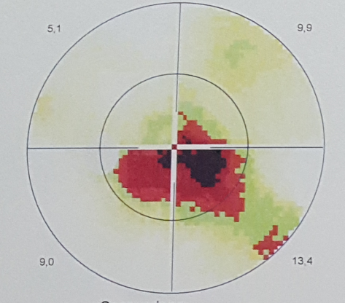
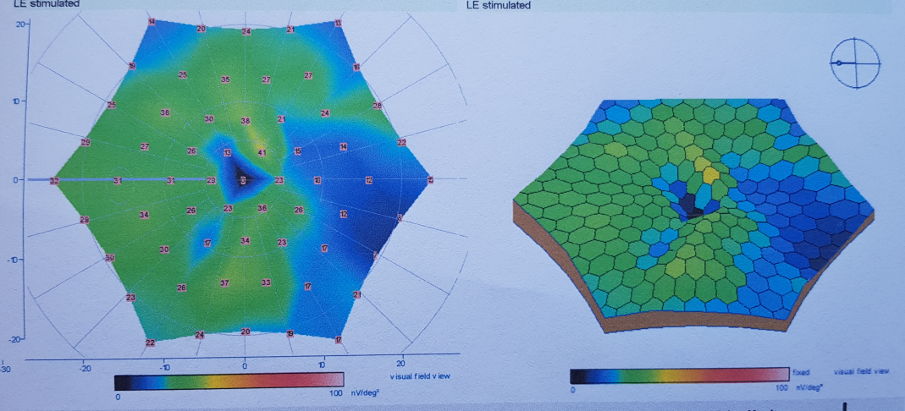
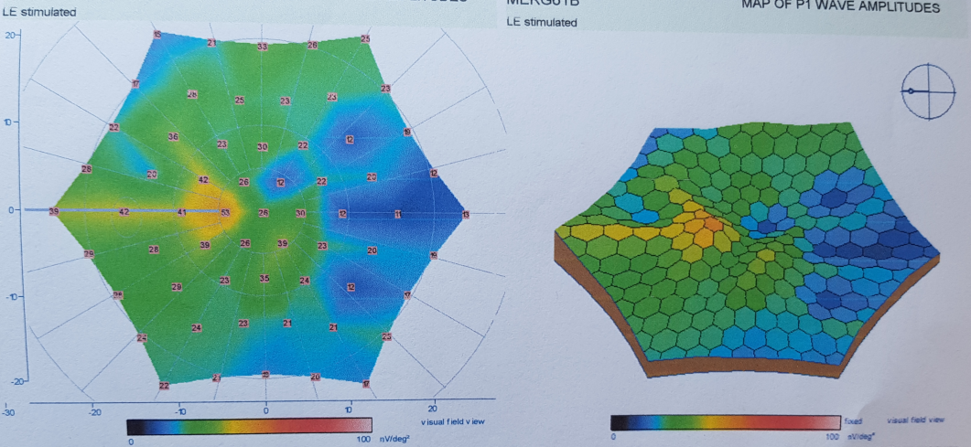
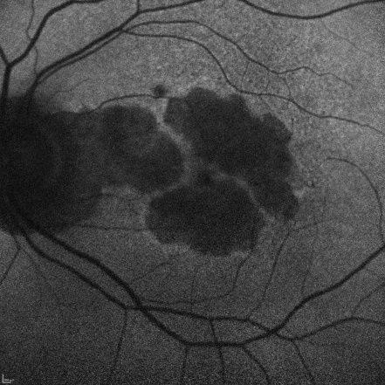
OLGU- YBMD
65 years old, Female , AMD patient
VA: Preop:1 meter counting finger
Post op: 0.05 Snellen lines

Slide 15
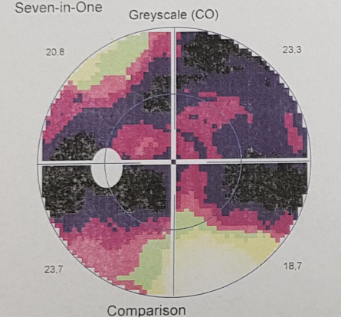
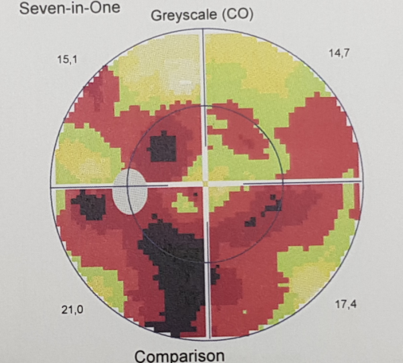
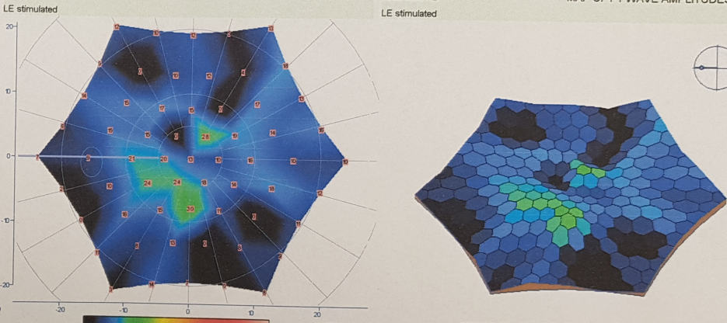
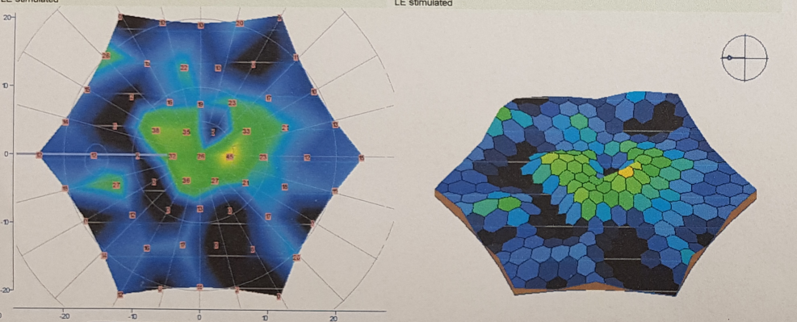
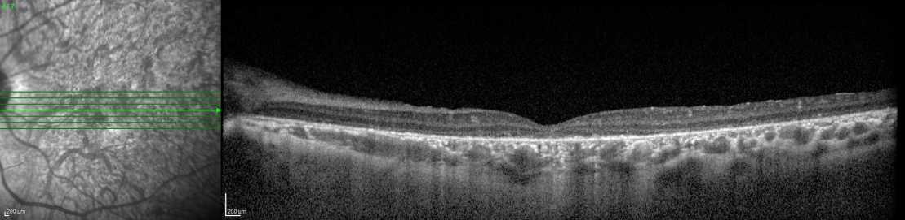
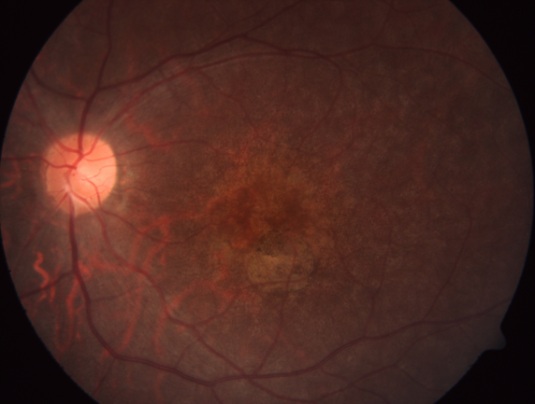

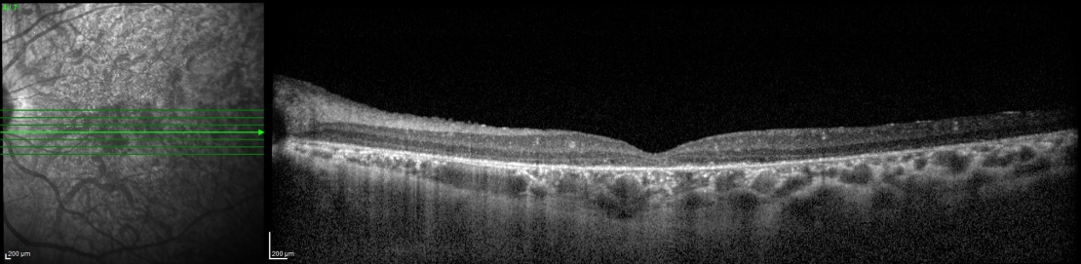
27 y Stargardts’ MD
VA: From 1 mcf to 0.05

Slide 16
In another patients group, same method and same stem cell source were used.
Suprachoroidal adipose tissue-derived MSC implantation in patients with optic nerve diseases was performed.
This prospective, single-center, phase ½ study enrolled 4 eyes of 4 patients with optic atrophy of various reasons.
None of them had any systemic or ocular complications. All of the patients experienced visual acuity improvement, visual field improvement and improvement in the mfERG recordings.

Slide 17
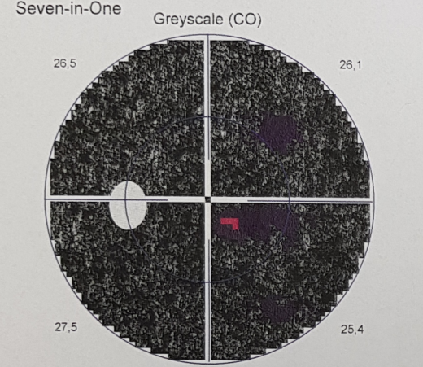
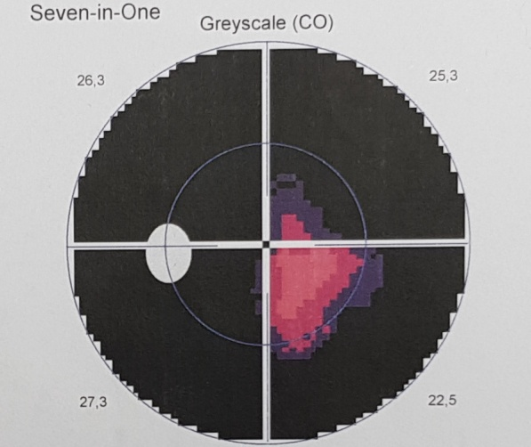
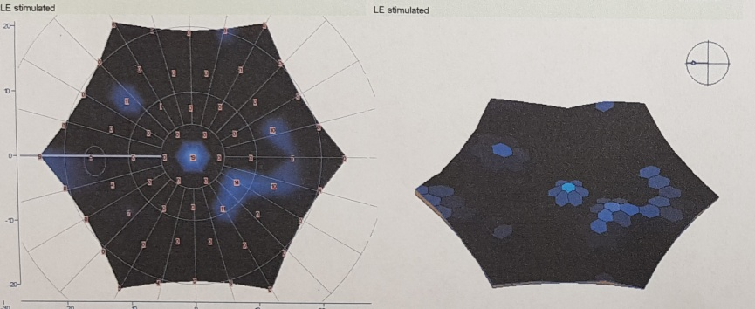
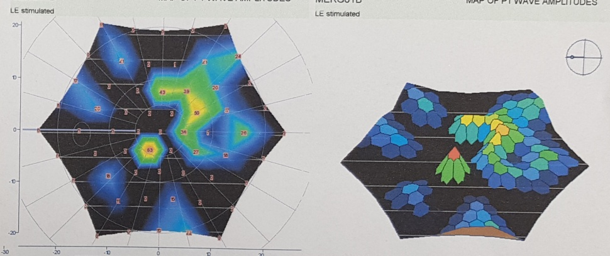
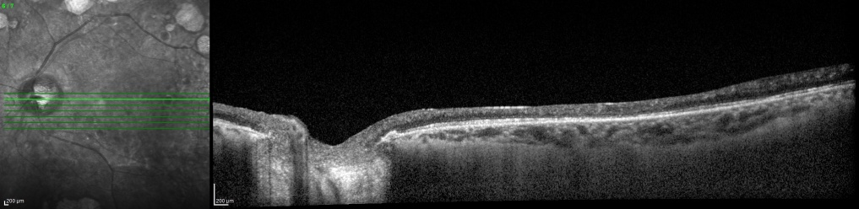
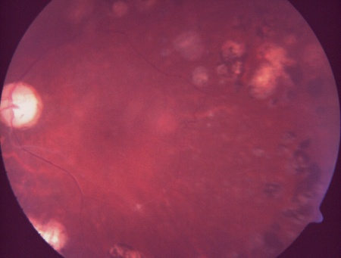
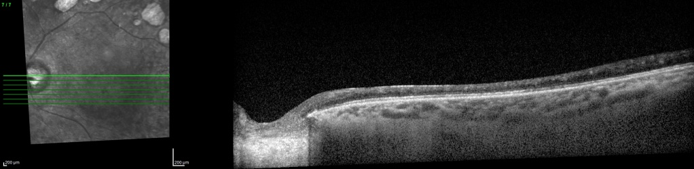
OLGU: OPTİK ATROFİ
60 years, Male,
Diabetic OA
VA: Preop:30cm HM
Postop: 1 m. CF

Slide 19
Suprachoroidal
Umbilical cord derived MSC
Prospective, single-center, phase 3 clinical study enrolled 124 eyes of 82 patients who had a confirmed diagnosis of RP.
The patients received 5 million UC-MSCs to the suprachoroidal area with the same surgical procedure.
There were statistically significant improvements in BCVA and VF during the study. The amplitudes of the P1 waves in the central areas showed significant improvements in mfERG recordings.

Slide 20
Vaka

Slide 21










