Slide 1

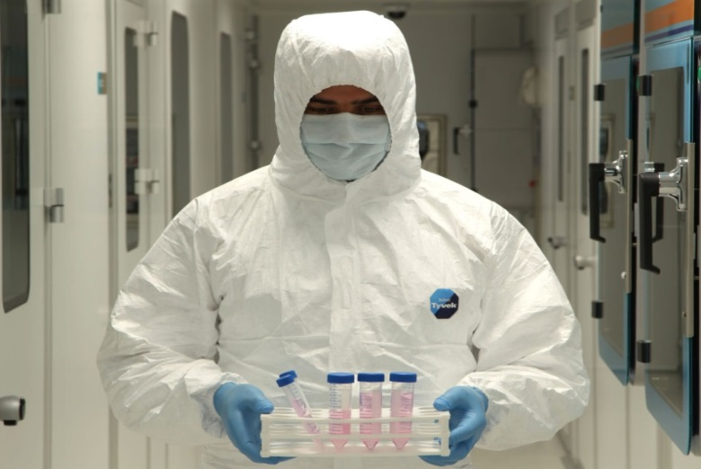

STEM CELL THERAPIES IN RETINAL DEGENERATIONS
Prof.Dr. Ayşe Öner, FEBO
Erciyes University Medical Faculty
Ophthalmology Dept. KAYSERİ
SOE Konferansı -2015
TOD Ulusal Kongresi
Notes:
Prof.Dr. Yusuf ÖZKUL

Slide 2
I have no financial interest to disclose

Slide 3

1996- Clone Sheep Dolly

Slide 4
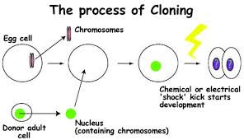

Slide 5



Slide 6
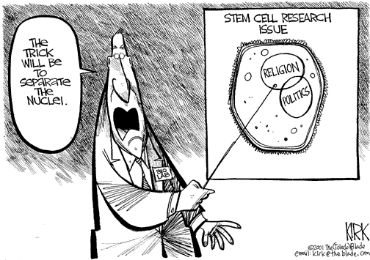

Slide 7
MAIN TOPICS
What is stem cell?
What are the types and properties of stem cell?
Applications in retinal diseases?
Clinical trials about retinal diseases in the world ?
Where are we in our country?

Slide 8
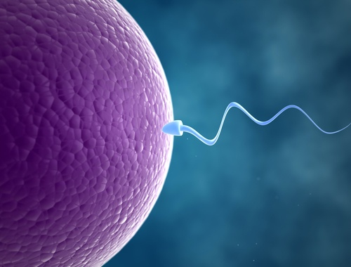



Slide 9
WHAT IS STEM CELL?
Stem cell:
Has the remarkable potential to develop into many different cell types in the body.
Serve as a sort of internal repair system.
When divides, each new cell has the potential either to remain a stem cell or become another type of a specialized cell.

Slide 10
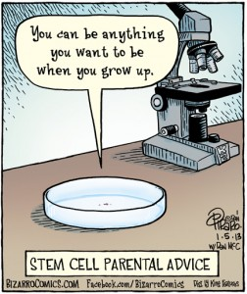
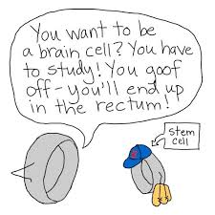

Slide 11
History of Stem Cells
1981: Discovery of embryonic stem cells from early mouse embryos.
1998: Stem cells from human embryos are derived in the laboratory and called human embryonic stem cells (hESCs)
2006: Researchers "reprogrammed" some specialized adult cells genetically to assume a stem cell-like state ( induced pluripotent stem cells) (iPSCs),
2009: With the permission of the FDA, the first hESC clinical trial was approved for spinal cord injury.

Slide 12
TYPES OF TRANSPLANTATION
Xenogenic (from another species)
Allogenic (from another individual)
Autogenic (from the same individual)

Slide 13
UNIQUE PROPERTIES OF SC
Self-renewal
Differentiation
Proliferation

Slide 14
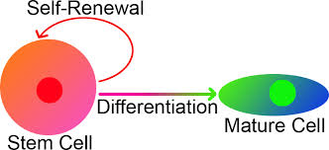
PROLIFERATION-SELF-RENEWAL
Proliferation: Stem cells are capable of dividing and replicating themselves for long periods.
Self –renewal: If the resulting cells after division continue to be unspecialized, like the parent stem cells, the cells are said to be capable of long-term self-renewal.

Slide 15
DIFFERENTIATION
Differentiation: When unspecialized stem cells give rise to specialized cells, the process is called differentiation.
There are internal and external signals during differantiation.
The internal signals are controlled by a cell's genes
The external signals for cell differentiation include chemicals secreted by other cells, physical contact with neighboring cells, and certain molecules in the microenvironment.

Slide 16





POTENCY OF SC
Totipotent
Pluripotent
Multipotent
Oligopotent
Unipotent

Slide 17
Totipotent:
Unlimited proliferation capacity
Capacity to differentiate into embriyogenic and extra embriyogenic cells.
Capacity to form a whole human body (endoderm, mesoderm and ectoderm)
All of the cells of the embrio in the first week after fertilization are totipotent

Slide 18
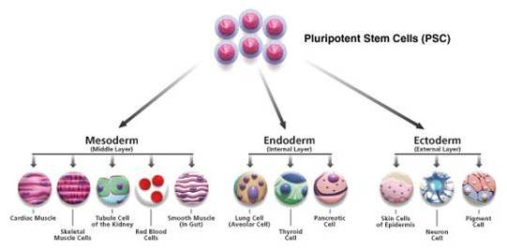
Pluripotent:
Capacity to differentiate into embriyogenic cell layers (endoderm, mesoderm, ectoderm)

Slide 19

Pluripotent:
Human embriyogenic stem cells (hESC) are pluripotent.
İPSC s are pluripotent.

Slide 20
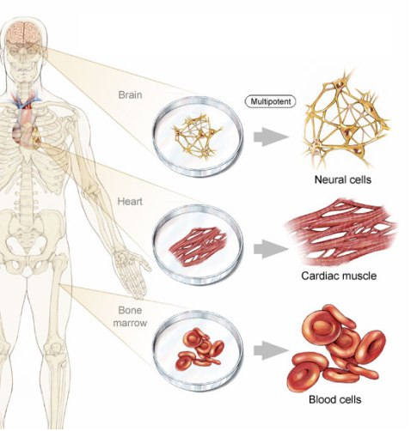
Multipotent
Capacity to differentiate limited types of cell types.
Adult stem cells are multipotent

Slide 21
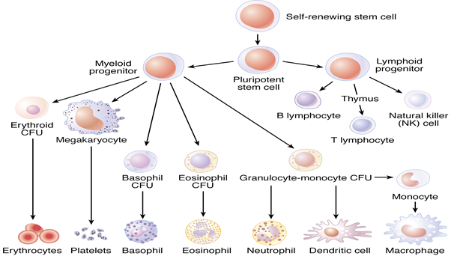
Oligopotent
Capacity to differentiate into a few cell types.
Hematopoetic stem cells are oligopotent.

Slide 22
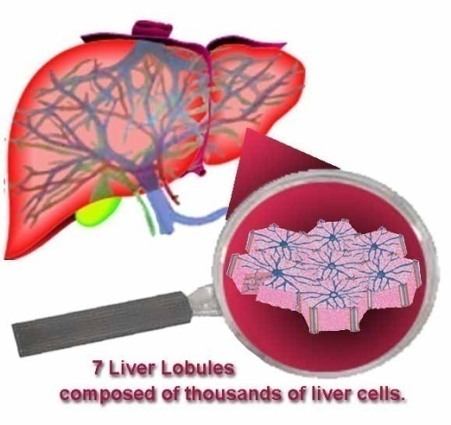
Unipotent
Capacity to form only one type of cell. Skin cell, hepatocyte.

Slide 23
TYPES OF STEM CELLS
1-EMBRYONIC STEM CELLS
2- ADULT STEM CELLS
- Mesencymal SC
- İnduced Pluripotent SC
3-CORD BLOOD STEM CELLS
4- AMNIOTIC FLUID STEM CELLS

Slide 24
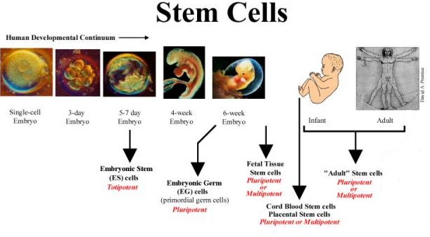
TYPES OF STEM CELLS

Slide 25
Embryonic (ES) SC and Foetal SC
Derived from human embryos that are few days old or foetus
Have the potential to become almost any type of cell.
Can be grown easily but difficult to manipulate.
Possibility of rejection

Slide 26

ETHICAL ISSUES- EMBRYO IS DESTROYED

Slide 27
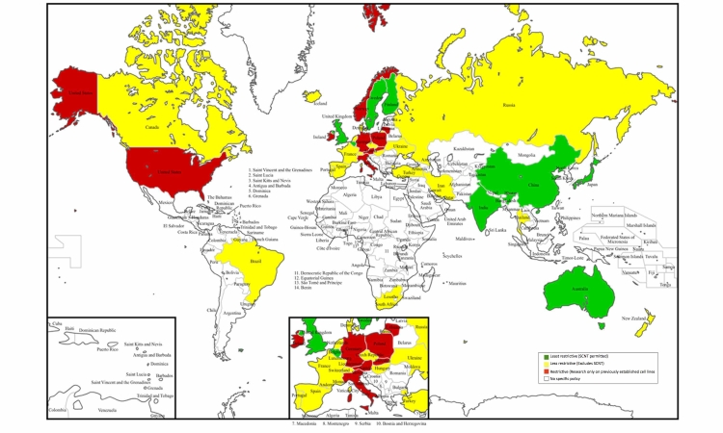
hESC MAP

Slide 28
Adult SC
Found in all humans and can be obtained easily
Sometimes difficult to grow in culture. (Long time)
Can currently form a limited number of cell types
The primary roles of adult stem cells are to maintain and repair the tissue in which they are found.
Rejection is less likely

Slide 29
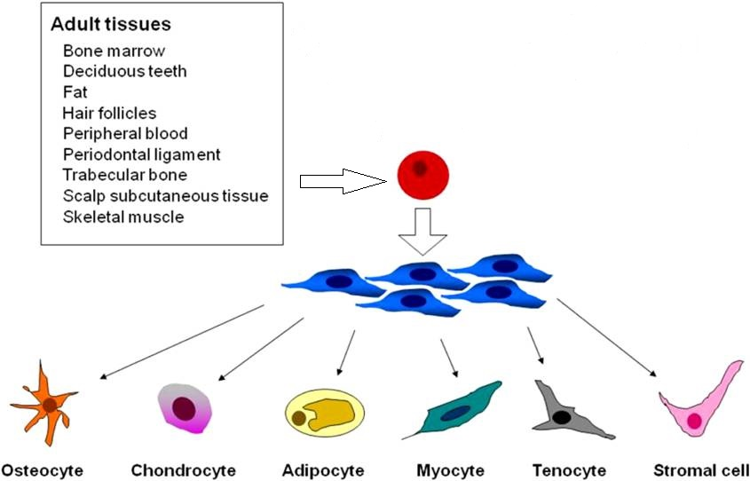

Slide 30
Induced Pluripotent SC (IPSC)
Adult somatic cells reprogramed to become like embryonic stem cells (induced pluripotent stem cells, iPSCs)
Viruses are currently used to introduce the reprogramming factors (OCT4, SOX2, KLF4 and c-MYC) into adult cells.
Limited availibility with difficult techniques.
Cost is high.
Teratogenity and rejection are the problems.

Slide 31
STATUS IN OUR COUNTRY
Human ESCs are restricted in our country (2005)
Adult SCs and IPSC can be used with the approval
of Local Ethical Committee and Ministry of Health
(Please read TCK: 90)

Slide 32
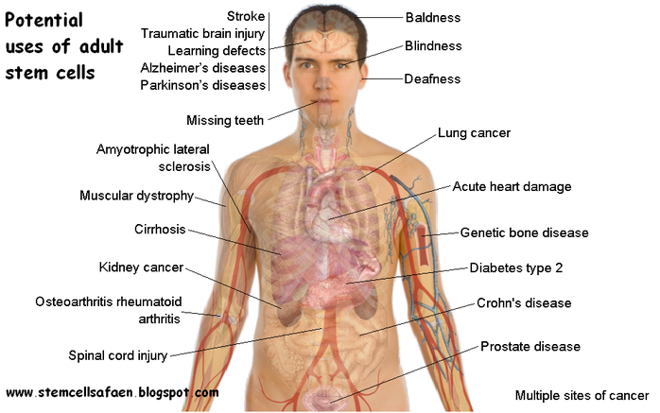
SC in CLINICAL PRACTICE

Slide 33
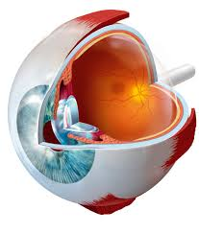
SC in OPHTALMOLOGY
CORNEA AND RETINA

Slide 34
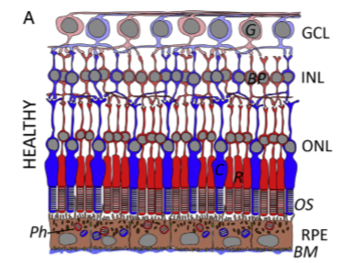
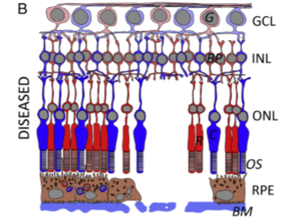
SC in RETINAL DISEASES
Very complex tissue
Has 10 different layers and 9 types of cells connected with each other.
An alteration or damage in any of these layers can impair these communications, thereby affecting the normal circulation, anatomy and functions of the retina.

Slide 35
Mechanisms of Stem Cell Therapy
THERE ARE FOUR MECHANISMS:
(1) Cell replacement: Healthy stem cells can replace degenerated cells
(2) Nutritional support: Healthy stem cells secrete some trophic factors and promote the survival of surrounding cells.
(3) Protect the retinal blood vessels and photoreseptors by upregulating antiapoptotic genes and nutritional factors.
(4) Promote new synaptic connections.

Slide 36
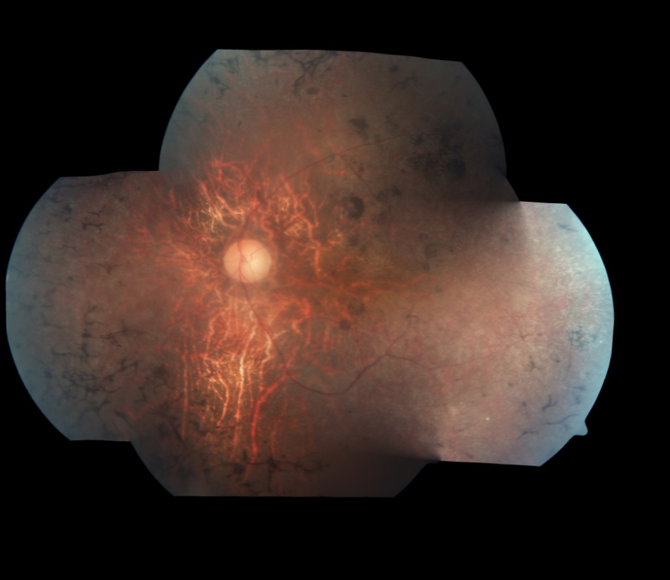
TARGET RETINAL DISEASES ARE THE DISEASES
WITH NO DEFINITIVE TREATMENTS

Slide 37
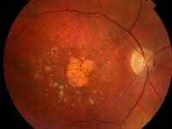
Age Related Macular Degeneration (AMD)
AMD is a complex disease.
It involves loss of the RPE/photoreceptor layers, thinning of the outer plexiform layer, thickening of Bruch's membrane and atrophy of the choriocapillaris.
AMD has a strong genetic characteristic with over 50 different loci identified so far.

Slide 38
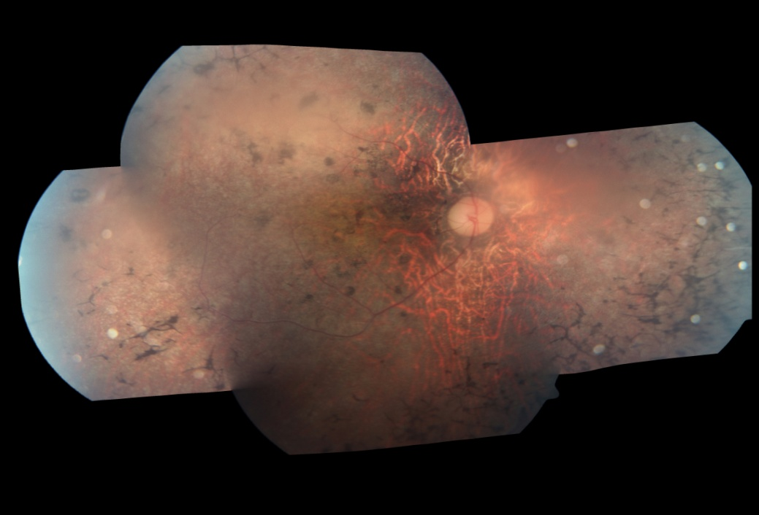
Retinitis Pigmentosa
RP is the most common form of inherited progressive retinal dystrophy
Heterogeneous both clinically and genetically.
Progressive loss of rod photoreceptors then RPE cells and cones.

Slide 39
RP
RP can be inherited in autosomal dominant, autosomal recessive, X-linked, mitochondrial and genetically more complex modes.
More than 60 different genes have been associated with RP.
It can occur in the retina alone or together with other syndromes

Slide 40
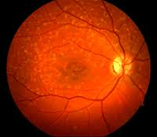
Stargardt Macular Dystrophy
Stargardt disease is the most common form of inherited juvenile macular degeneration almost always A-R
Stargardt disease typically develops during childhood and adolescence.
The progressive vision loss is caused by the death of RPE and photoreceptor cells in the central portion of the retina called the macula.

Slide 41
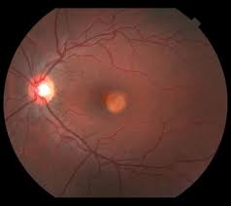
Best Vitelliform Macular Distrophy
- Autosomal dominant hereditary maculopathy with childhood-onset accumulation of liposfuscin in RPE
-Develop progressive central acuity loss and metamorphopsia, due to mutations in bestrophin.
-There are different stages in the disease process including CNVM and geographic atrophy in later stages.

Slide 42
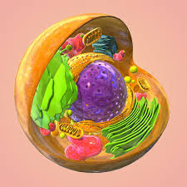
WHICH KIND OF STEM CELLS
CAN BE USED IN RETINAL DEGENERATIONS?

Slide 43
ESC- In-vitro
In-vitro studies showed that these cells have the potential to differentiate into both neural and epithelial retinal cells
Decembrini S, et al. Derivation of traceable and transplantable photoreceptors from mouse embryonic stem cells. Stem Cell Reports 2014; 2: 853-865 .
Gonzalez-Cordero A, et al. Photoreceptor precursors derived from three-dimensional embryonic stem cell cultures integrate and mature within adult degenerate retina. Nat Biotechnol 2013; 31: 741-747 .
Garita-Hernández M, et al. Hypoxia increases the yield of photoreceptors differentiating from mouse embryonic stem cells and improves the modeling of retinogenesis in vitro. Stem Cells 2013; 31: 966-978.
Diniz B, et al. Subretinal implantation of retinal pigment epithelial cells derived from human embryonic stem cells: improved survival when implanted as a monolayer. Invest Ophthalmol Vis Sci 2013; 54: 5087-5096.
Juuti-Uusitalo K, et al. Aquaporin expression and function in human pluripotent stem cell-derived retinal pigmented epithelial cells. Invest Ophthalmol Vis Sci 2013; 54: 3510-3519.
Zhu Y, et al. Three-dimensional neuroepithelial culture from human embryonic stem cells and its use for quantitative conversion to retinal pigment epithelium. PLoS One 2013; 8: e54552 .

Slide 44
ESC- In-vitro
Mouse and human ES cells can develop into a three-D optic cup in culture that remarkably resembles the embryonic vertebrate eye.
Zhu Y, et al. Three-dimensional neuroepithelial culture from human embryonic stem cells and its use for quantitative conversion to retinal pigment epithelium. PLoS One 2013; 8: e54552.
Eiraku M, et al. Self-organizing optic-cup morphogenesis in three-dimensional culture. Nature. 2011; 472:51–56.
Nakano T, et al. Self-formation of optic cups and storable stratified neural retina from human ESCs. Cell Stem Cell. 2012; 10:771–785.

Slide 45
ESC-Animal Studies
ESCs are able to differentiate into neural stem cells, photoreceptors and RPE cells.
ESC-derived photoreceptor precursor cells were able to integrate when transplanted into degenerated adult mouse retina.
These cells matured toward outer segments and formed synaptic connections.
Decembrini S, et al. Derivation of traceable and transplantable photoreceptors from mouse embryonic stem cells. Stem Cell Reports 2014; 2: 853-865 .
Diniz B, et al. Subretinal implantation of retinal pigment epithelial cells derived from human embryonic stem cells: improved survival when implanted as a monolayer. Invest Ophthalmol Vis Sci 2013; 54: 5087-5096.
Stanzel BV et al. Stem Cell Reports. 2014 Jan 2;2(1):64-77. Human RPE stem cells grown into polarized RPE monolayers on a polyester matrix are maintained after grafting into rabbit subretinal space.

Slide 46
ESC-Clinical Studies
Two prospective phase 1/2 studies with subretinal transplantation of hESC-derived RPE
9 patients with Stargardt's macular dystrophy and 9 with dry AMD.
Follow-up period was median of 22 months.
There was no evidence of adverse proliferation, rejection, or serious ocular or systemic safety issues.
13 (72%) of 18 patients had patches of increasing subretinal pigmentation
Best-corrected visual acuity improved in 10 eyes, improved or remained the same in 7 eyes, and decreased in one eye, whereas the untreated fellow eyes did not show similar improvements in visual acuity.
Vision-related quality-of-life measures increased for general and peripheral vision, and near and distance activities.
Schwartz SD et al. Human embryonic stem cell-derived retinal pigment epithelium in patients with age-related macular degeneration and Stargardt's macular dystrophy: follow-up of two open-label phase 1/2 studies. Lancet. 2015 Feb 7;385(9967):509-16.

Slide 47
REGISTERED TRIALS WITH ESC clinicaltrials.gov
(1) (NCT01469832) Safety and Tolerability of Sub-retinal Transplantation of hESC-RPE Cells in Patients with Stargardt's Macular Dystrophy (SMD)
(2) (NCT01691261) A Study of Implantation of hESC-RPE Subjects with Acute Wet AMD and Recent Rapid Vision Decline
(3) (NCT01674829) A Phase Ⅰ/Ⅱa, Open-Label, Single-Center, Prospective Study to Determine the Safety and Tolerability of Subretinal Transplantation of hESC-RPE (MA09hRPE) Cells in Patients With Advanced Dry AMD
(4) (NCT02122159) Research With Retinal Cells Derived From Stem Cells for Myopic Macular Degeneration
(5) (NCT01344993) Safety and Tolerability of Sub-retinal Transplantation of hESC Derived RPE (MA09-hRPE) Cells in Patients with Advanced Dry AMD
(6) (NCT01345006) Sub-retinal Transplantation of hESC Derived RPE (MA09-hRPE) Cells in Patients with Stargardt's Macular Dystrophy;
(7) (NCT01625559) Safety and Tolerability of MA09-hRPE Cells in Patients with SMD.

Slide 48
Induced PSCs-In-vivo and In vitro
Like ESCs, iPSCs are able to differentiate in several
retinal cells, such as the photoreceptors, RPE, retinal
ganglion like cells and retinal progenitor cells .
Zhou L, et al. Differentiation of induced pluripotent stem cells of swine into rod photoreceptors and their integration into the retina. Stem Cells 2011; 29: 972-980
Kamao H, et al. Characterization of human induced pluripotent stem cell-derived retinal pigment epithelium cell sheets aiming for clinical application. Stem Cell Reports 2014; 2: 205-218 [
Maeda T, et al. Retinal pigmented epithelial cells obtained from human induced pluripotent stem cells possess functional visual cycle enzymes in vitro and in vivo. J Biol Chem 2013; 288: 34484-34493
Maruotti J, et al . A simple and scalable process for the differentiation of retinal pigment epithelium from human pluripotent stem cells. Stem Cells Transl Med 2013; 2: 341-354
Reichman S, et al. From confluent human iPS cells to self-forming neural retina and retinal pigmented epithelium. Proc Natl Acad Sci USA 2014; 111: 8518-8523
Mekala SR, et al Derivation, characterization and retinal differentiation of induced pluripotent stem cells. J Biosci 2013; 38: 123-134
Singh R, et al Functional analysis of serially expanded human iPS cell-derived RPE cultures. Invest Ophthalmol Vis Sci 2013; 54: 6767-6778
Meng F, et al . Induction of retinal ganglion-like cells from fibroblasts by adenoviral gene delivery. Neuroscience 2013; 250: 381-393.
Satarian L, et al. Engrafted human induced pluripotent stem cellderived anterior specified neural progenitors protect the rat crushed optic nerve. PLoS One 2013; 8: e71855.

Slide 49
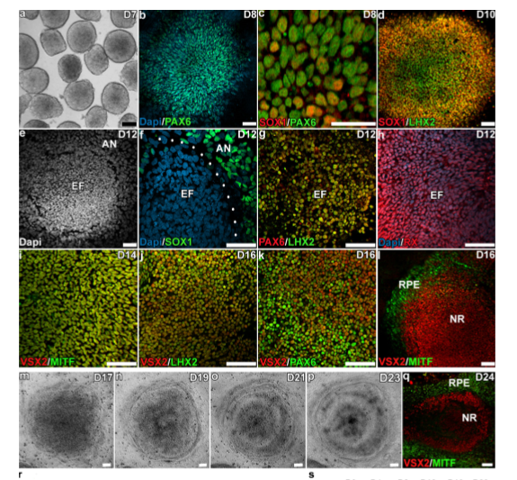
iPS Cells- In vitro
iPS cells can form optic vesicle-like structures that could be used as a model system to study the development of the retina.
Zhong et al. Formation of 3 D total retina from iPSC in vitro. Nat Commun. Author manuscript; available in PMC 2015 March 23

Slide 50
REGISTERED CLINICAL TRIALS WITH IPSC clinicaltrials.gov
(1) (NCT02162953) Development of Induced Pluripotent Stem Cells from Patients with Best Disease and Other Inherited Retinal Degenerative Diseases
(2) (NCT01432847) Generation of induced pluripotent stem (iPS) Cell Lines from Somatic Cells of Participants with Eye Diseases and from Somatic Cells of Matched Controls.

Slide 51
Bone Marrow Derivated MSC
Differentiate into neuralcells, astrocytes, RPE and photoreceptor-like cells.
Expressed photoreseptor and neuronal markers.
KicicA, et al. Differentiation of marrow stromal cells into photoreceptors in the rat eye. J of Neuroscience 2003;23(21):7742-7749 .
- PanH,LiuX,WuJ,TianY,ZhangS,LinZ,HuangQ.Fateandprotective effect of marrow stromal cells after subretinal transplantation. 2008;40(3):202-208
- HuoDM,et al. Differentiation of mesenchymal stem cell in the microenviroment of retinitis pigmentosa Int J Ophthalmology 2010;3(3):216-219

Slide 52
Registered Clinical Trials with BMDMSC
1) NCT01736059- Clinical Trial of Autologous Intravitreal Bone-marrow CD34+ Stem Cells for Retinopathy. Non-exudative AMD, Diabetic Retinopathy. RVO, RP, Hereditary Macular Degeneration.
2) NCT01560715- Autologous Bone Marrow-Derived Stem Cells Transplantation For RP (RETICELL)
3) NCT02280135- Clinical Trial of Intravitreal Injection of Autologous Bone Marrow Stem Cells in Patients With Retinitis Pigmentosa (TC/RP)
4)NCT01068561- Autologous Bone Marrow-Derived Stem Cells Transplantation For Retinitis Pigmentosa
5) NCT01914913- Clinical Study to Evaluate Safety and Efficacy of BMMNC in Retinitis Pigmentosa
6) NCT01531348-Feasibility and Safety of Adult Human Bone Marrow-derived Mesenchymal Stem Cells by Intravitreal Injection in Patients With Retinitis Pigmentosa
7) NCT01518127-Intravitreal Bone Marrow-Derived Stem Cells in Patients With Macular Degeneration (AMDCELL)

Slide 53
Case Reports
3 patients with end stage RP received intravitreal autologous BMDSCs
At the end of the one year the vision was unchanged (End stage RP) .
There were no complications.
But this report suggests that the injection of stem cells into the vitreous cavity is technically feasible.
Jonas, J.B.; et al. Intravitreal autologous bone marrow-derived mononuclear cell transplantation: A feasibility report. Acta Ophthalmol. 2008, 86, 225–226.
Jonas, J.B.; et al. Intravitreal autologous bone-marrow-derived mononuclear cell transplantation. Acta Ophthalmol. 2010, 88, e131–e132.

Slide 54
Reticell Study-NCT01560715
20 RP with RP received intravitreal BM-derived stem cells.
The vision-related quality of life (VRQOL) of patients using the National Eye Institute Visual Function Questionnaire-25 (NEI VFQ-25) before treatment and 3 and 12 months after treatment.
There was a significant improvement in the quality of life of patients 3 months after treatment, whereas by the 12th month there was no statistically significant difference from baseline.
There were no ocular and systemic complications.
Siqueira et al. Stem Cell Research & Therapy (2015) 6:29 Quality of life in patients with retinitis pigmentosa submitted to intravitreal use of bone marrow-derived stem cells (Reticell -clinical trial)

Slide 55
Reticell Study
They also demonstrated that autologous BMDSCs had a positive effect on cystoid macular oedema (CMO) associated with RP.
The improvement of the oedema led to an improvement in visual acuity and an improvement in macular sensitivity, as measured by the microperimetry test.
Siqueira, R.C.; et al. Resolution of macular oedema associated with retinitis pigmentosa after intravitreal use of autologous BM-derived hematopoietic stem cell transplantation. Bone Marrow Trans. 2013, 48, 612–613

Slide 56
Adipose tissue derivated MSC
ADMSCs are a source of adult stem cells which can be obtained by a minimally invasive procedure.
They can be easily expanded under standard culture conditions.

Slide 57
ADMSC
These stem cells have been differentiated into many cell types, including retinal progenitor cells and RPE.
In addition, these cells have been found to exert paracrine effects showing neuroprotective effects on RPE damage in vitro.
Moviglia GA, et al. In vitro differentiation of adult adipose mesenchymal stem cells into retinal progenitor cells. Ophthalmic Res 2012; 48 Suppl 1: 1-5
Vossmerbaeumer U et al. Retinal pigment epithelial phenotype induced in human adipose tissue-derived mesenchymal stromal cells. Cytotherapy 2009; 11: 177-188
Singh AK, et al. Pastor JC. Adipose derived mesenchymal stem cells partially rescue mitomycin C treated ARPE19 cells from death in co-culture condition. Histol Histopathol 2013; 28: 1577-1583.
Yang Z, et al. Amelioration of diabetic retinopathy by engrafted human adipose-derived mesenchymal stem cells in streptozotocin diabetic rats. Graefes Arch Clin Exp Ophthalmol 2010; 248: 1415-1422.
Notes:
Yang Z, et al. Amelioration of diabetic retinopathy by engrafted human adipose-derived mesenchymal stem cells in streptozotocin diabetic rats. Graefes Arch Clin Exp Ophthalmol 2010; 248: 1415-1422.

Slide 58
Registered Trials with ADMSC
(1) (NCT02024269) Study to Assess the Safety and Effects of Cells Injected Intravitreal in Dry Macular Degeneration
(2) (NCT02144103) Effectiveness and Safety of Adipose-Derived Regenerative Cells for Treatment of Glaucomatous Neurodegeneration.

Slide 59
OUR CLINICAL STUDY
Phase 1 safety study.
Approval of the Ethical Committee of University (March-2014)
Approval of Health Ministry (January-2015)
20 Volunteers with end-stage RP

Slide 60
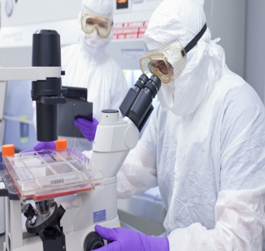

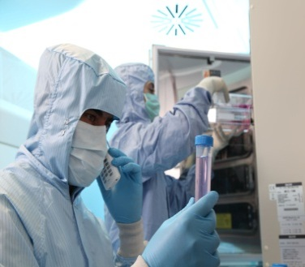
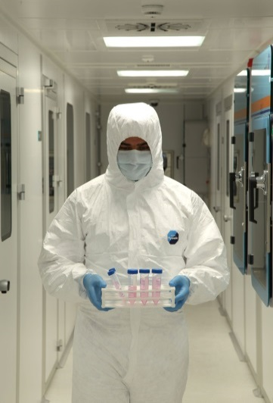
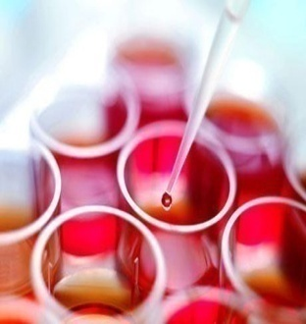

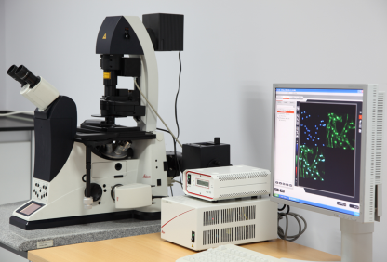
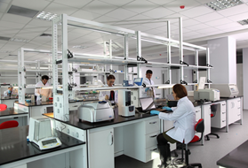

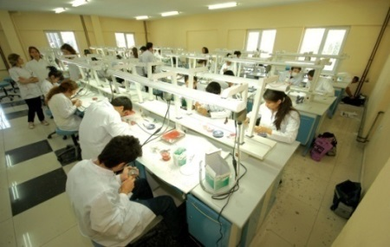
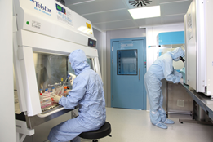
GENKÖK

Slide 61
All had total visual field defect.
% 50 of the patients were only p +
The best VA was hand motion from 1 meter.
All had udetectable ERG.
The worse eye was operated.
After total vitrectomy with 23 gauge, 1.000.000 SCs were injected subretinally.
Adipose Tissue Derivated MSC s were used.

Slide 62

GMP (Good manufacturing practice)
ADMSCs were prepared within the international standarts

Slide 63
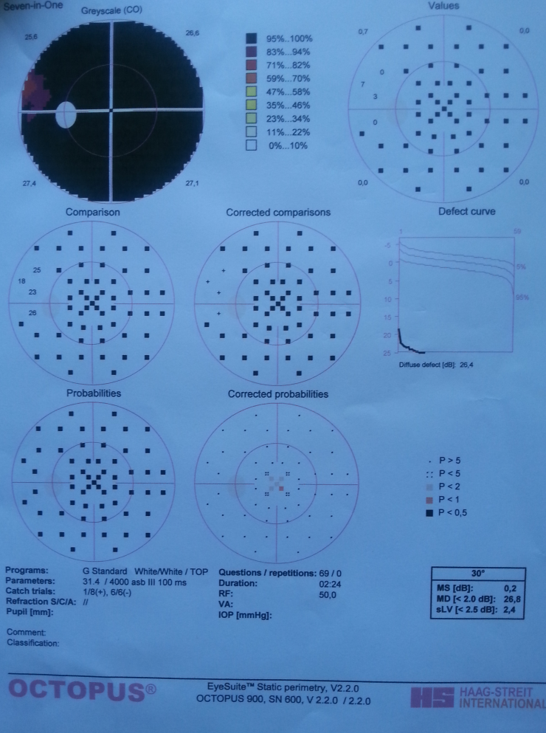
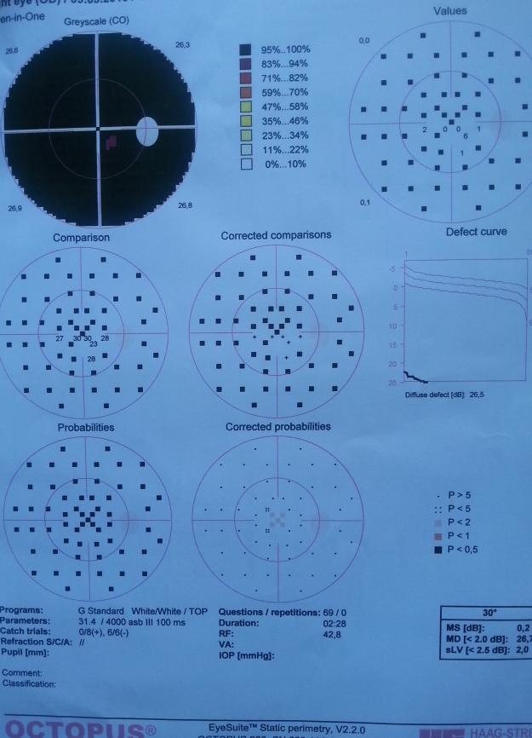
Two examples for visual field examination

Slide 64
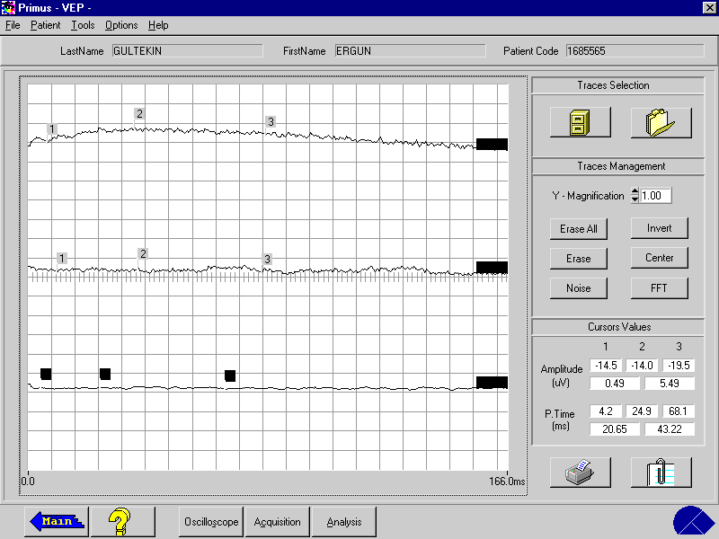
An example for ERG

Slide 65
RESULTS
11 patients completed 6 month follow-up.
None of them had systemic complications.
5 had no ocular complications.
One had CNVM at the transplantation site and received intravitreal anti-VEGF drug for once.
5 had ERM and peripheral PVR and received
second PPV and silicon oil injection.

Slide 66
RESULTS
Only 1 had visual acuity improvement (From 1 mhm to 0.05) and a slight ERG improvement .
3 mentioned that the light and some colors are brighter than before although there was not an improvement in VA.
The other 7 had no VA improvement
(6 of them were p+ )

Slide 67
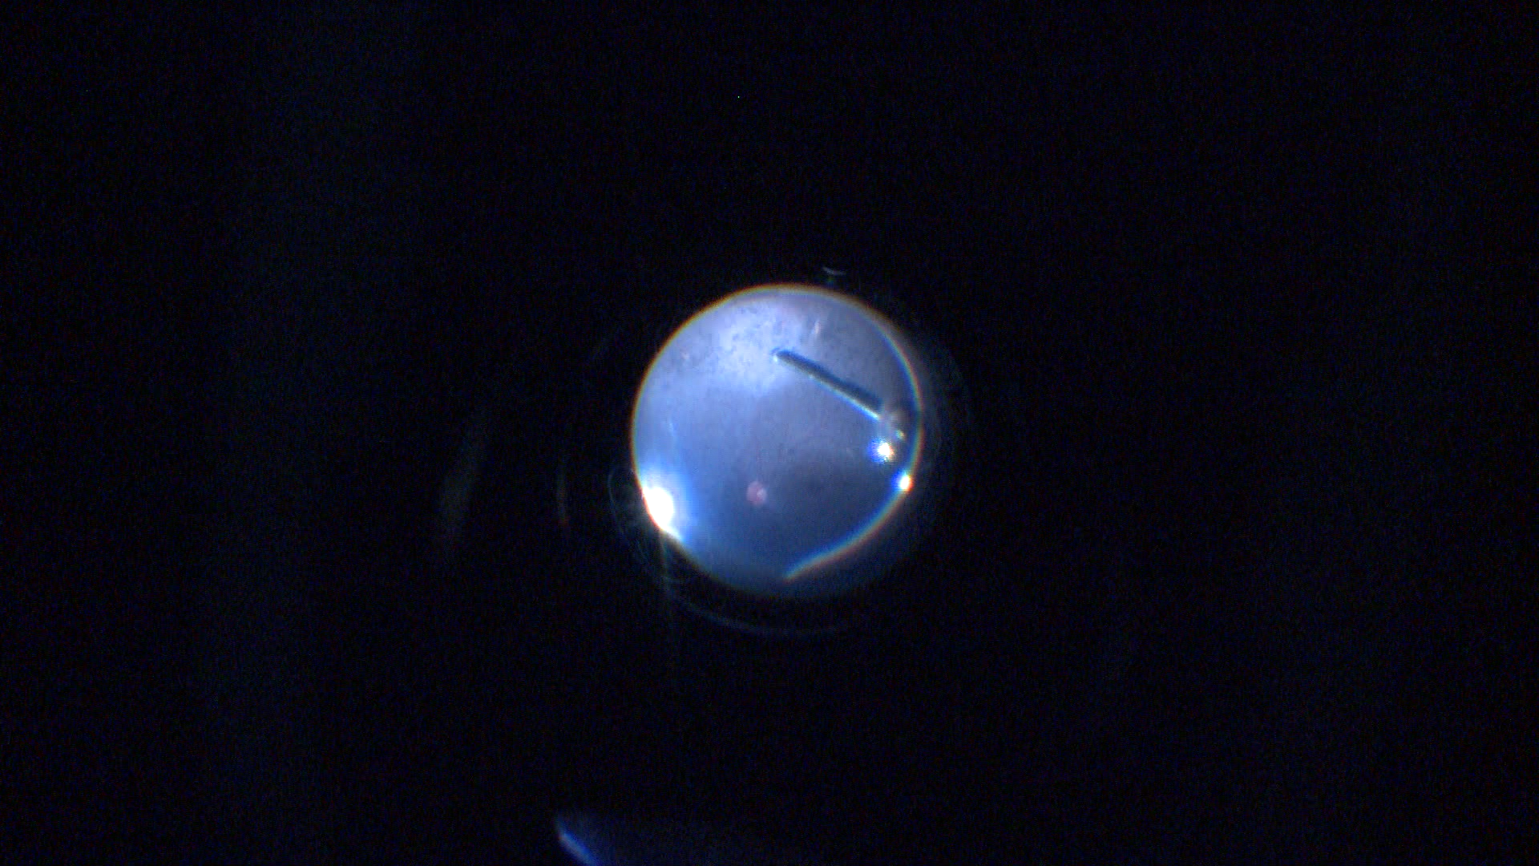

Slide 68
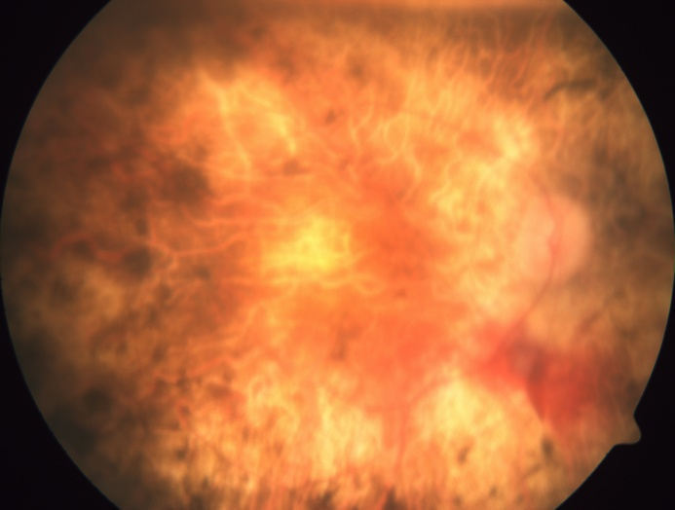
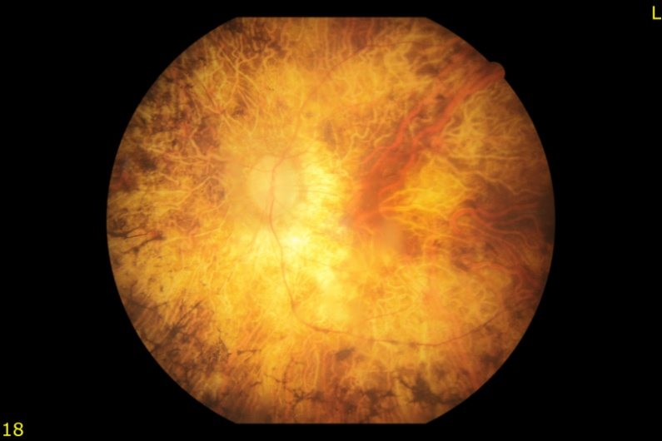
The same patient: Right eye 1 day after surgery and the left eye

Slide 69
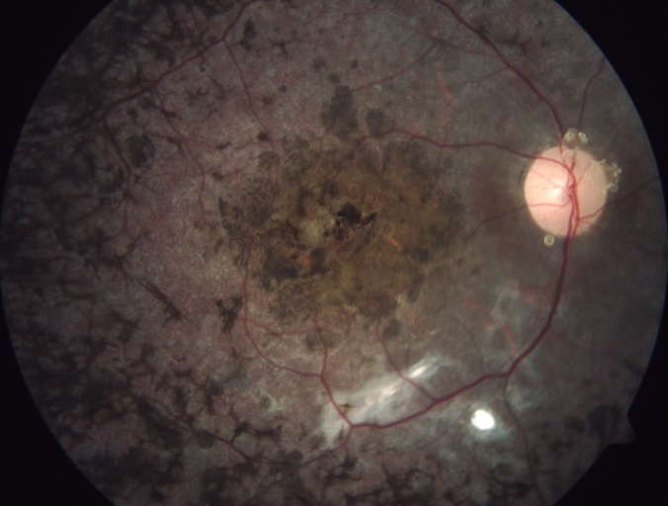
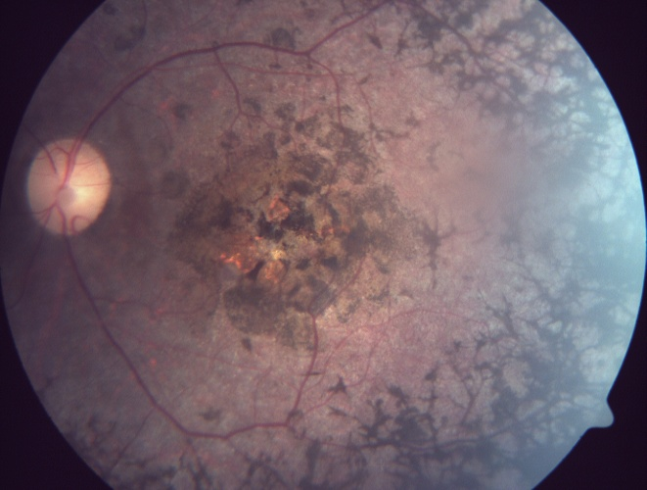
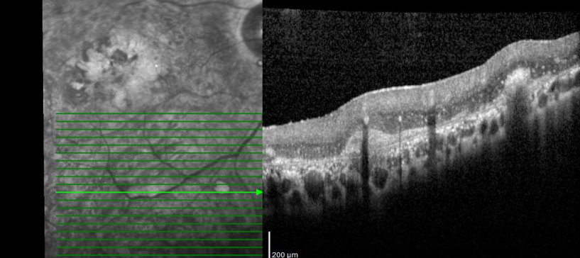
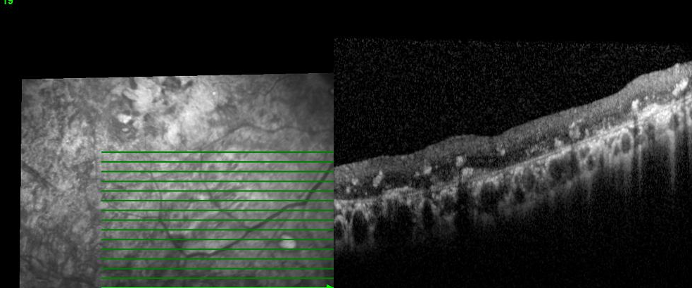
Fundus images of a patient at the sixth month
OCT at first week and at sixth month.
Right eye was treated, left eye was untreated.

Slide 70
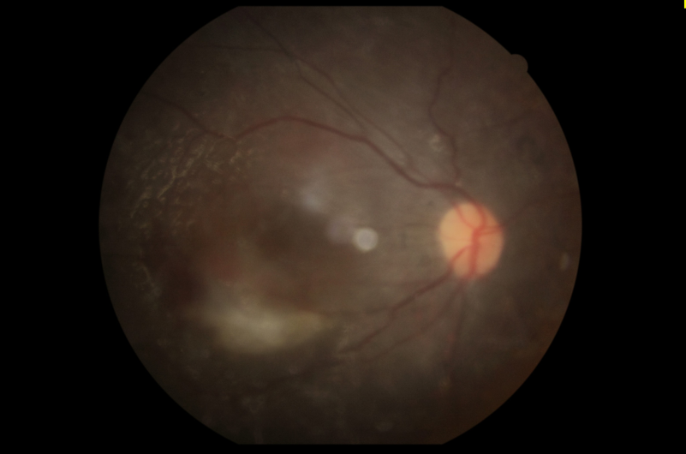
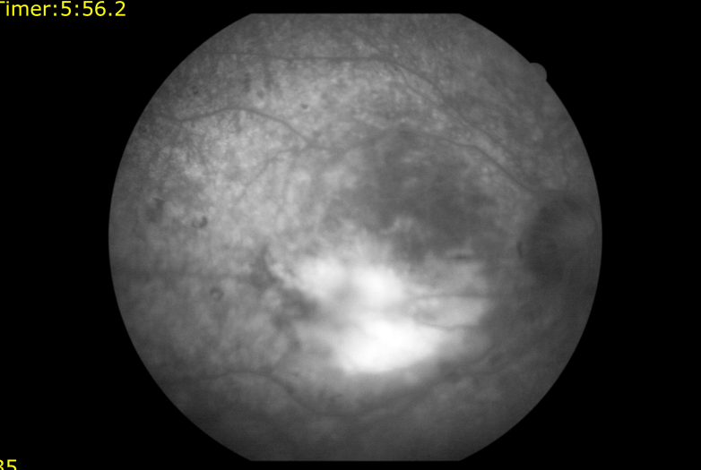
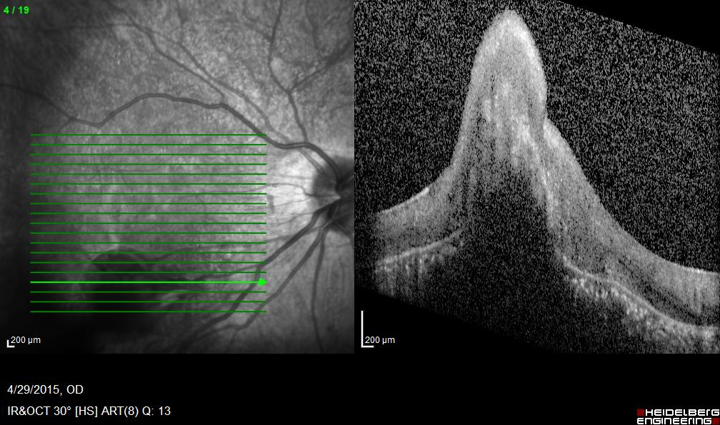
The patient with CNVM: Fundus image, angiography and OCT

Slide 71

CONCERNS ABOUT SC

Slide 72
SAFETY- Tumor Formation?
Despite all the advantages of SCs, (especially ESCs) tumor formation is considered an important risk for the clinical application of these stem cells.
Cui L, et al. WNT signaling determines tumorigenicity and function of ESC-derived retinal progenitors. J Clin Invest 2013; 123: 1647-1661.

Slide 73
IMMUN REACTION ?
SCs are known to be immunsupressive.
Subretinal region is belived to be immune privileged because of the presence of the blood–brain and blood–retinal barriers.
Immunosuppression is not necessary as long as the blood–retinal barrier was not damaged by the transplantation procedure.
Some researchers recommend immunsupressive drugs for human.
Hambright, D.; et al. Long-term survival and differentiation of retinal neurons derived from human embryonic stem cell lines in un-immunosuppressed mouse retina. Mol. Vis. 2012, 18, 920–936.

Slide 74
Low Rate of Cell Survival and Migration
But a low rate of transplanted cell survival is a major problem in stem cell therapy.
Researchers suggest that the OLM presents a physical barrier to photoreceptor integration following transplantation into the subretinal space in the adult mouse.
Pharmacological disruption of the outer limiting membrane leads to increased retinal integration of transplanted photoreceptor precursors.
Chen, L.F.; et al. Localization and developmental expression patterns of CSPG-cs56 (aggrecan) in normal and dystrophic retinas in two rat strains. Exp. Neurol. 2012, 234, 488–498.
Tucker, B.A.; et al. Transplantation of adult mouse iPS cell-derived photoreceptor precursors restores retinal structure and function in degenerative mice. PLoS One 2011, 6, e18992. 114.
Pearson, R.A.; et al. Targeted disruption of outer limiting membrane junctional proteins (Crb1 and ZO-1) increases integration of transplanted photoreceptor precursors into the adult wild-type and degenerating retina. Cell Transpl. 2010, 19, 487–503.
Jiang, C.; et al. Laser injury promotes migration and integration of retinal progenitor cells into host retina. Mol. Vis. 2010, 16, 983–990.
West, E.L.; et al. Pharmacological disruption of the outer limiting membrane leads to increased retinal integration of transplanted photoreceptor precursors. Exp. Eye Res. 2008, 86, 601–611.

Slide 75
STANDART PROTOCOL?
Which kind of stem cell is most suitable for stem cell therapy?
What is the perfect dosage?
What is the most suitable way ? Subretinal, intravitreal?
What is the most suitable stage for patients to received the cells?

Slide 76

IN THE FUTURE

Slide 77

MSC Industrial Supply has over 100 branches and five major Customer Fulfillment Centers strategically located throughout the United States. to serve your needs quickly and efficiently. No matter where you are, we can get inventory to you fast.
MSC Industrial Supply Branch Locations

Slide 78

THANK YOU FOR YOUR İNTEREST

