Slide 1
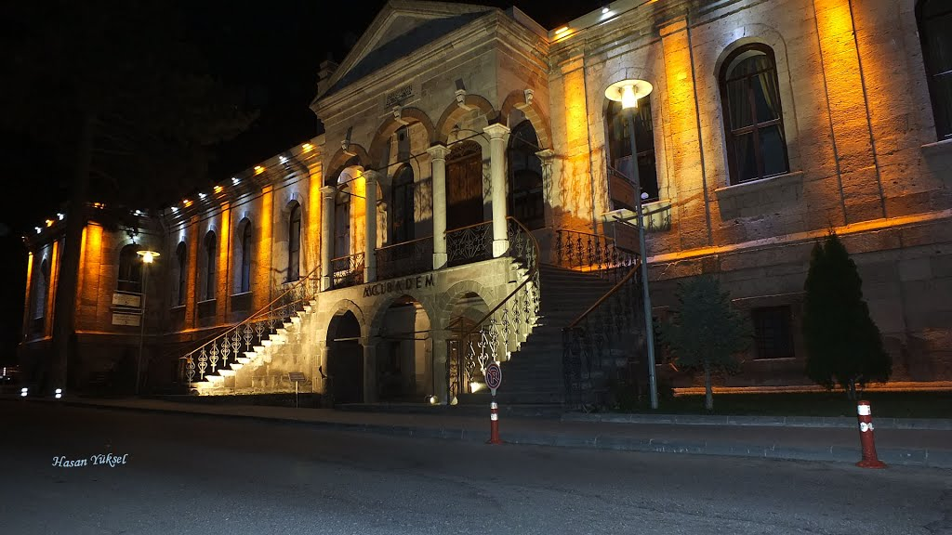
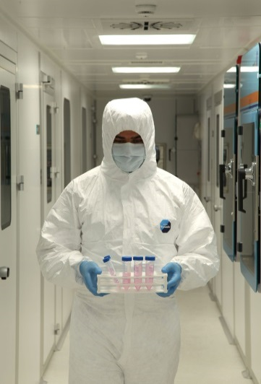
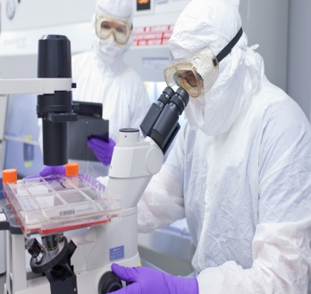
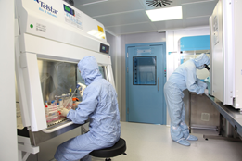
Mesenchymal stem cell Implantation In advanced stage retInItIs pIgmentosa: 6 month results of a phase 2 study
DR. NESLİHAN SİNİM KAHRAMAN FEBO
Prof. dr. ayşe öner FEBO
KAYSERİ ACIBADEM HOSPİTAL

Slide 2
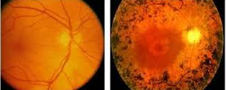

AIM
Retinitis pigmentosa (RP) is a potentially blinding disease with severe visual impairments detected in early ages of life.
The presence of nyctalopia, visual field construction from periphery to the fovea, bone spicule pigmentation in the retina and a reduction in electroretinograms (ERG) are seen as the findings of the disease.
There is no curative treatment for the disease up to date.
New approaches including restoring defective genes and stem cell transplantation have been under investigation

Slide 3

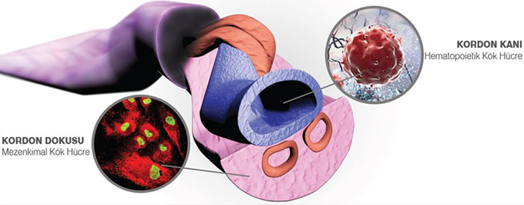
Stem cell implantation, following the succesful results of experimental studies in recent years, is now available as a treatment option to restore visual function in these diseases.
This study aimed to investigate the safety and efficacy of suprachoroidal mesenchymal stem cell (MSC) implantation inadvanced stage retinitis pigmentosa patients.
In this study we use umblical cord- derived mesenchymal stem cells (MSCs) which are a non-embriyonic stem cells.

Slide 4
method
The worse eye of the patient was operated by Limoli Retinal Restoration Technique and received suprachoroidal MSC implantation.
Patients were evaluated on the first day, first week, first month, third and sixth month postoperatively. BCVA, anterior segment and fundus examination, color photography, optical coherence tomography (OCT), visual field examination were carried out at each visit.
Fundus fluorescein angiography (FFA) and multifocal electroretinography (mf ERG) recordings were performed at the end of the first, third and sixth month and anytime if necessary during the follow-up.

Slide 5
Results

Slide 6
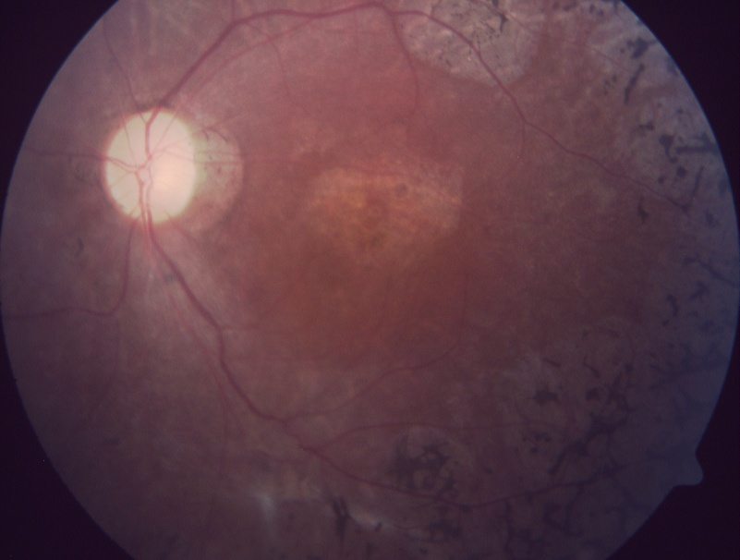
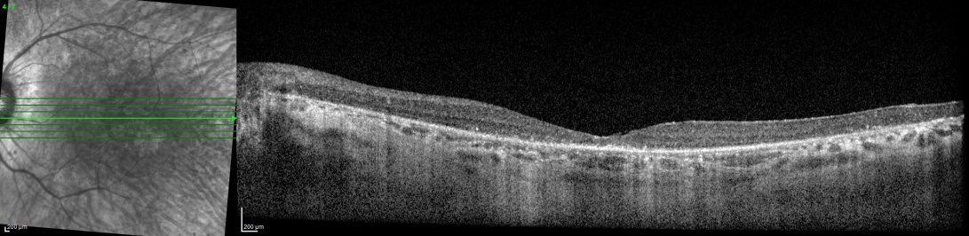

Slide 7
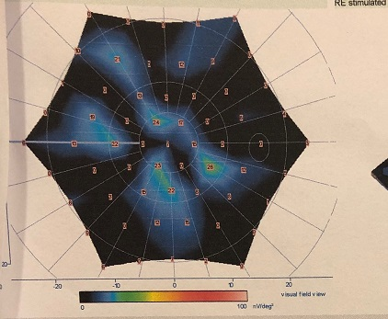
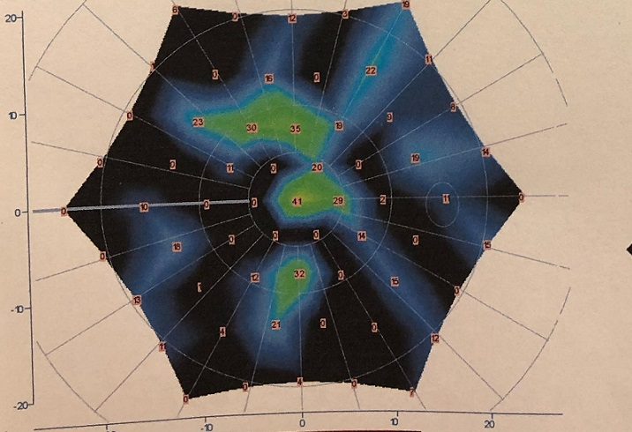

Slide 8
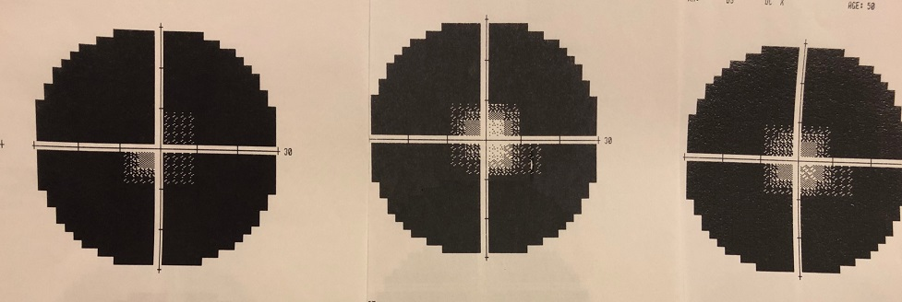

Slide 9
Dıscussıon
Clinical studies have shown that the implantation of stem cells is safe and has no serious adverse effects in patients with advanced stage retinitis pigmentosa.
In the Reticell-clinical study, the researchers analyzed the effect of intravitreal use of autologous bone marrow-derived MSCs (BMSSCs) on the quality of life of 20 patients with RP. Three months after treatment, they found a statistically significant improvement in patients' quality of life.
Seventeen patients with bilateral visual loss due to RP were included in “Stem Cell Ophthalmology Treatment Study SC (SCOTS) protocol and followed for at least 6 months. Thirty three eyes were treated and 15 eyes had an increase, 15 eyes remained stable and 3 eyes deteriorated.

Slide 10
In this study, we use Limoli retinal restoration technique as a stem cell implantation technique without ocular complication and we found an improvement in visual performance of the treated eyes at 6 months follow-up.
And also we use first time human umbilical cord-derived mesenchymal stem cells (MSC) which is widely used as a rich and ethically acceptable stem cell source
It is known to have higher proliferative potential than other MSC sources such as bone marrow and adipose tissue.

Slide 11
conclusıon

Slide 12


