Slide 1
Evaluation of retina with optical coherence tomography in patients with retinitis pigmentosa
Oner A et al.
Erciyes University Medical Faculty, Ophthalmology Department
Kayseri-TURKEY

Slide 2
Purpose
Evaluation of the relationship between
macular optical coherence tomography (OCT)
parameters with visual functions in patients
with retinitis pigmentosa (RP).

Slide 3
Material and Method
One hundred and fifty-three eyes of 79 patients were included into the study.
Mean visual acuity of the patients were converted to logMAR values.
Integrity of the outer retinal layers, presence of cystoid macular edema (CME) and vitreoretinal surface abnormalities were evaluated, and central macular thickness (CMT) was calculated with OCT.

Slide 4
Results
Mean visual acuity was 1.2 ± 0.9 logMAR.
Mean CMT was 199.95±149.47 µm in RP group. This value was 316.82 ± 208.35 µm in cases with CME, and 179.27 ± 126.70 µm when cases with CME were withdrawn.
There was a negative correlation between the patients’ ages and visual acuities with their CMT.
Twelve of the eyes (8%) had epiretinal membrane while 9 eyes (6%) had macular hole.
All patients had disintegrity of outer retinal layers of varying degrees.

Slide 5
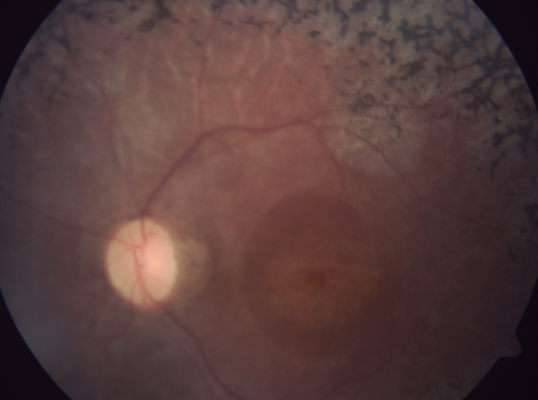
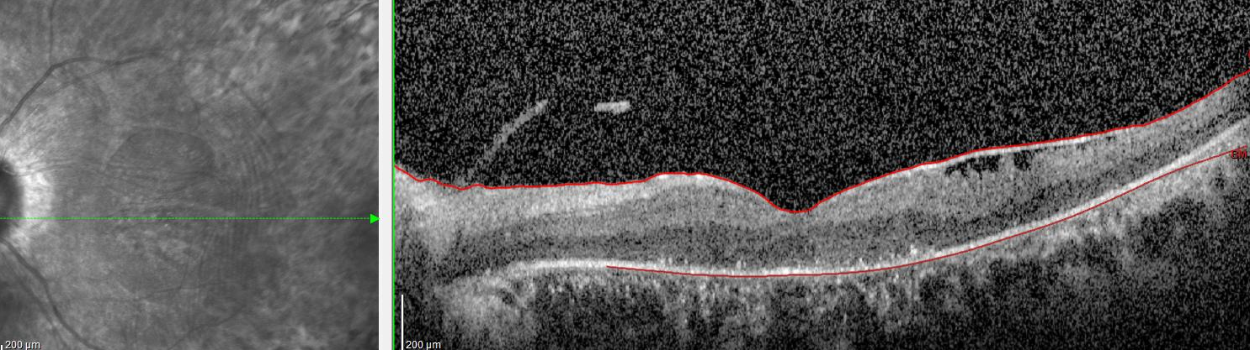
Figure 1
Figure 2
Figure 1: Color fundus photograph of one patient.
Figure 2: OCT of the same patient shows epiretinal membrane and
disintegrity of outer retinal layers.

Slide 6
Conclusion
With the aging and progression of the disease, visual acuity tend to decrease, central macula thins and disintegrity in the outer retinal layers increases.
Patients have a significant correlation between OCT changes and visual functions.
Optical coherence tomography is very helpful in determining retinal structure, morphological abnormalities and assessing the prognosis in patients with RP.

